Slide 1
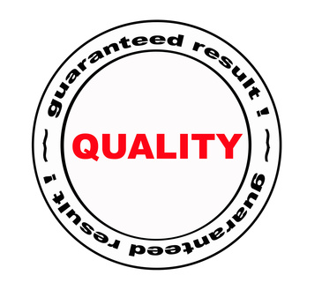
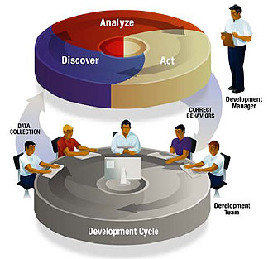



Lean & Six Sigma
Bret, Cris, & Jeff

Slide 2
Agenda
Evolution and History
Lean Operations
Lean Six Sigma
Continuous Improvement
Six Sigma
Summary and Questions

Slide 3
HISTORY
Total Quality Management
Total Quality Management (TQM) continually evolved beginning in the 1950s, with a focus on process management, customer quality, and use of data and systematic procedures for understanding and resolving problems.
Six Sigma
Six Sigma grew in the 1980s, beginning at Motorola and spreading to companies including General Electric and AlliedSignal. It incorporated TQM as well as Statistical Process Control (SPC) and expanded from a manufacturing focus to other industries and processes.

Slide 4
HISTORY
Lean Operations
Lean developed from the concepts comprising the Toyota Production System (TPS): elimination of waste of all types, including excess inventory and increased process speed. It established a focus on the customer definition of value and used that to determine the proper process timing and flow.
Lean Six Sigma
In the late 1990s, both AlliedSignal and Maytag independently designed programs which combined aspects of both Lean and Six Sigma. They cross-trained employees in both methodologies, creating project frameworks that combined the two techniques.

Slide 5
HISTORY
Six Sigma (1800-1920)
Lean (1980’s)
Lean Six Sigma (1990’s)

Slide 6
Continuous Improvement
Continuous Improvement can be traced to Taylor’s time studies
Toyota focused on lead time and achieved Henry Ford’s cost with GM’s variety
Motorola initiated “six sigma” to organize TQM tools into DMAIC
Deming, Baldrige and Shingo Prize’s are Descriptive systems
GE evolved six sigma into a Prescriptive quality system
Lean Six Sigma integrates Lead time, cost and quality; strategy drives projects
Fast
Innovation

Slide 7

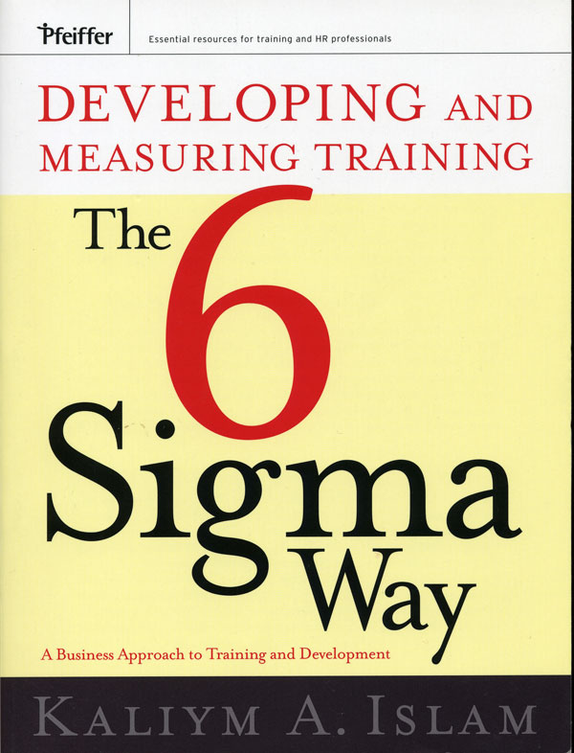

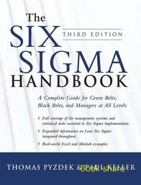

Slide 8
SIX SIGMA
Measurement Standard
  Frederick Gauss (1777-1855)
  Concept of the normal
Product Variation
    Walter Shewhart (1920’s)
Multiple Measurement Variations
  Motorola…trademark
  Bill Smith
  Coined the term “Six Sigma”

Slide 9
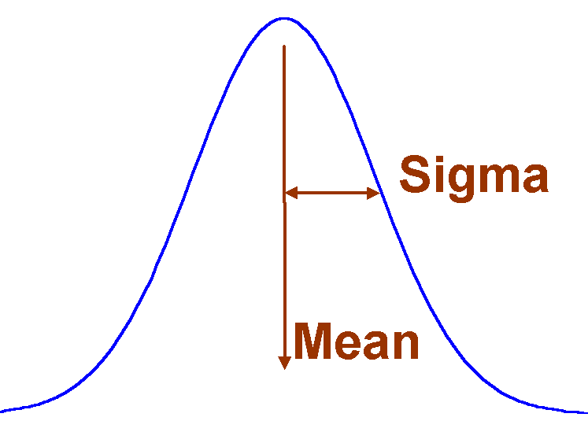
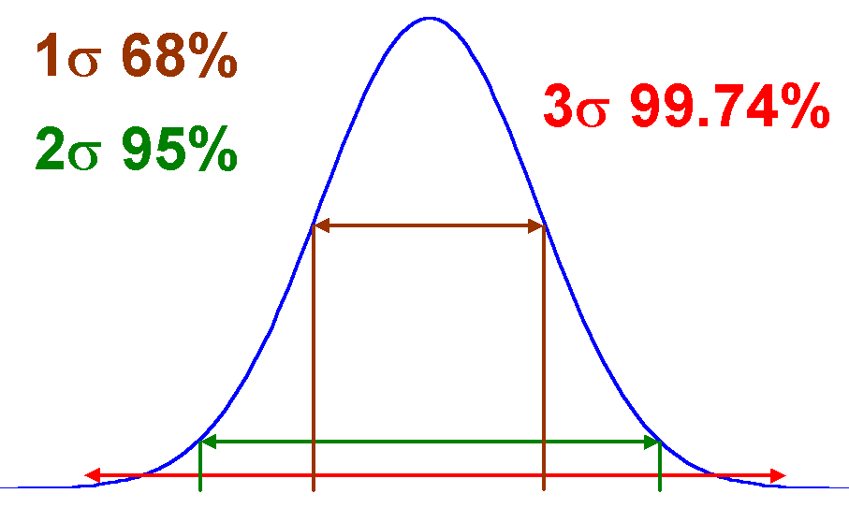
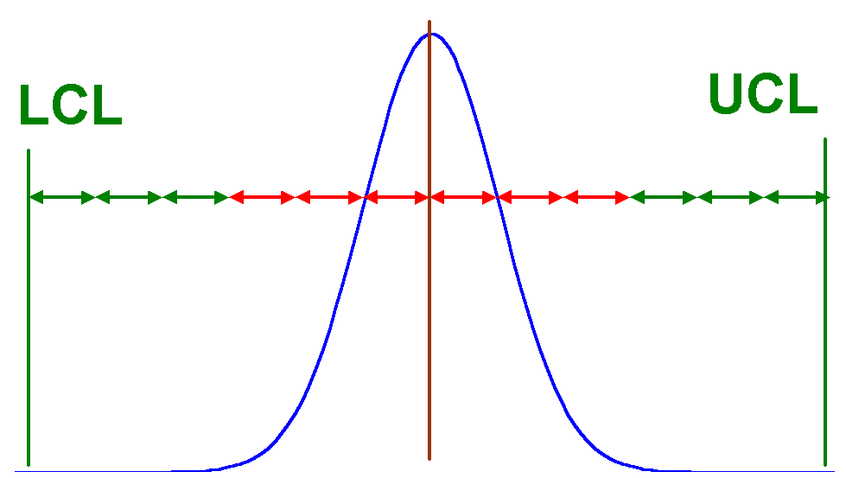
SIX SIGMA
Normal Distribution
Common Observations
Six Sigma is 99.99966% Success for the Customer

Slide 10
SIX SIGMA
Sigma Performance Levels - One to Six Sigma
Sigma Level | Defects Per Million Opportunities (DPMO)
1 | 690,000
2 | 308,537
3 | 66,807
4 | 6,210
5 | 233
6 | 3.4

Slide 11
SIX SIGMA
Real-world Performance Levels
Situation/Example | In 1 Sigma World | In 3 Sigma World | In 6 Sigma World
Pieces of your mail lost per year [1,600 opportunities per year] | 1,106 | 107 | Less than 1
Number of empty coffee pots at work (who didn't fill the coffee pot again?) [680 opportunities per year] | 470 | 45 | Less than 1
Number of telephone disconnections [7,000 talk minutes] | 4,839 | 467 | 0.02
Erroneous business orders [250,000 opportunities per year] | 172,924 | 16,694 | 0.9

Slide 12

SIX SIGMA
Methodologies
Six Sigma
Defect Reduction
DMADOV
DMADV
Cycle Time Reduction
CFPM
DMAIC
DSSS
Define
Measure
Analyze
Optimize
Verify
Define
Measure
Analyze
Design
Verify
Define
Measure
Analyze
Improve
Control
Develop
Six Sigma
Software
Cross
Function
Process
Mapping
Design & Manufacturing
Designing New Processes
Improving
Processes
Software
Development
Improving Cross-Functional Processes

Slide 13

SIX SIGMA…WHY ?
Practical orientation to the professional environment with the advisory and consulting perspective
Access to global practices to better understand and deploy methodologies
Usage of project management frame work to effectively execute projects
Eliminate costs in order to sustain effective results
Customization of processes and programs to suit specific organizational needs
Understanding business challenges in terms of Six Sigma
Effective usage of tools and interpretations of outcomes
Ability to create a low risk engagement model for organizational success

Slide 14


TRAINING EXERCISE

Slide 15


Lean Operations

Slide 16
LEAN OPERATIONS
What is Lean?
(Operations, Manufacturing, or Production)
Lean is about doing more with less: less time, inventory, space, labor, and money. "Lean manufacturing", a shorthand for a commitment to eliminating waste, simplifying procedures and speeding up production.
Driven by…cost, quality, delivery, safety, & morale

Slide 17
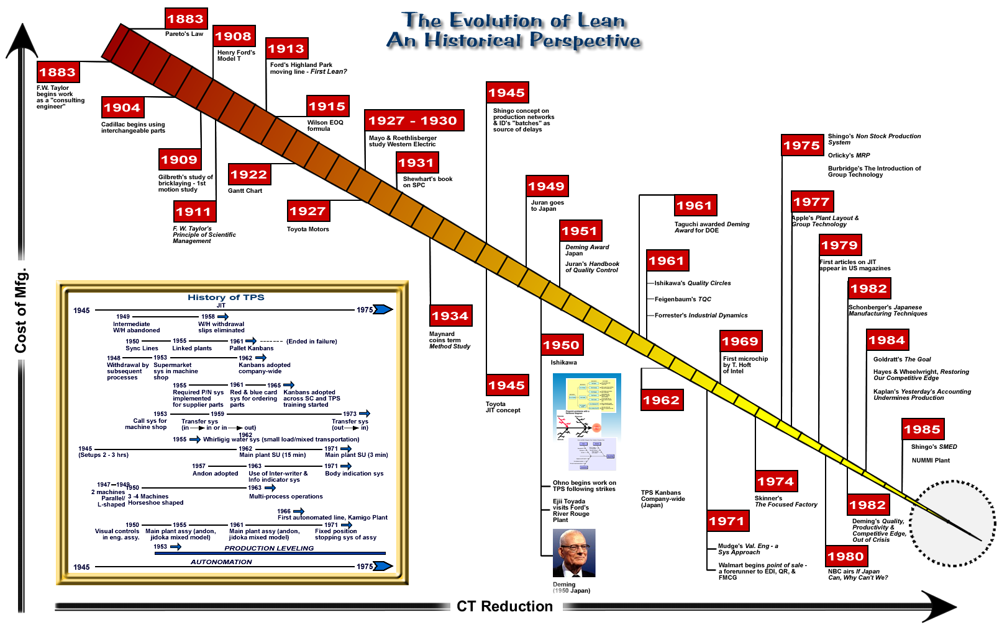
LEAN OPERATIONS

Slide 18
LEAN OPERATIONS
Toyota Production System
Empowers team members to optimize quality by constantly improving processes and eliminating unnecessary waste in natural, human and corporate resources.
Influences every aspect of Toyota’s organization and includes a common set of values, knowledge and procedures.
Entrusts employees with well-defined responsibilities in each production step and encourages every team member to strive for overall improvement.
Toyota Production System delivers the following key benefits:
Quality inherent in Toyota’s products
Costs are kept to a minimum thanks to a good return on investment
Delivery is on time, and to the expected standard, allowing Toyota’s customers to plan and maintain their operations successfully
Environmental concerns are shared by Toyota and its customers, from manufacturing through to recycling at end-of-life
Safety is Toyota’s constant concern – both for its employees and for those of its customers.

Slide 19
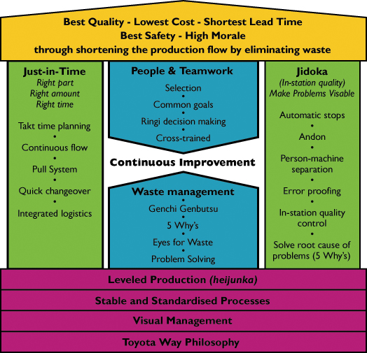
LEAN OPERATIONS

Slide 20
LEAN OPERATIONS
Goals:
Eliminate waste
Smooth flow
Minimize disruptions
Minimize inventory
Reduce queue, setup, wait, transit times
Reduce lead time
Introduce flexibility
Reduce cost

Slide 21
LEAN OPERATIONS
Requirements:
  Management commitment
  Quality
  Training
  Worker involvement / ownership
  Flexibility - people and equipment
  Process changes
  Supplier partnerships

Slide 22
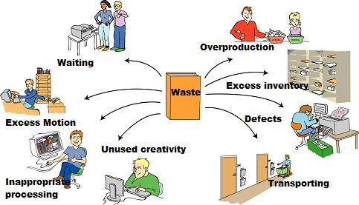
LEAN OPERATIONS
Reduction In Wastes…What Wastes?

Slide 23
LEAN OPERATIONS
How can you eliminate Waste? (Metrics of Measurement)
Overproduction: 1.Number of specimens delivered per hour 2.Number of batches per shift 3.Batch size passed between each process step | Wasted Motion: 1.Travel distance associated with completing all process steps one time 2.Spaghetti diagrams of your staff during peak operation times. 3.Walking distance to areas where materials, supplies, and/or specimens are obtained.
Transportation: 1.Steps associated with tube-travel diagrams 2.Time and distance specimens spend in courier cars 3.Distance your staff travels carrying reagents and supplies | Waiting: 1.Telephone time spent waiting to relay a critical results 2.Length of time patients wait for outpatient phlebotomy 3.Length of time technologists spend waiting for specimens

Slide 24
LEAN OPERATIONS
How can you eliminate Waste? (Metrics of Measurement)
Over processing: 1.Count the number of times specimens are sorted in specimen processing 2.Count the number of times technologists sort specimens before placing them on an analyzer 3.Count the number of times specimens are sorted before being placed into storage | Defects: 1.Track defects passed downstream from process step to process step 2.Count the number of corrected reports per day 3.Count the number of specimens that required clean-up (re-spun, redraw, re-label, etc.) prior to analysis per analyzer
Inventory: 1.Measure staff hours spent on ordering 2.Measure staff time spent on rotating stock 3.Measure the amount of consumables you have stored in the laboratory vs. in the store room | Staff Talents: 1.Count the number of process improvement suggestions received each day from staff 2.Measure staff morale and satisfaction levels 3.Count the number of continuing education hours devoted to training your staff on process improvement methodologies and project management

Slide 25
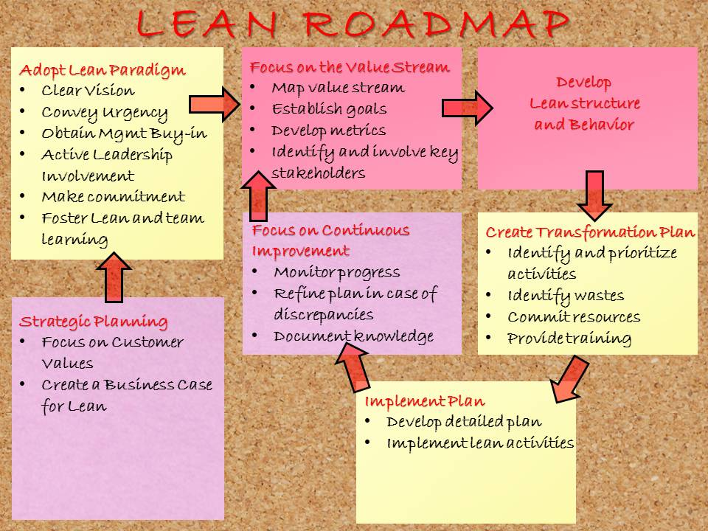
LEAN OPERATIONS

Slide 26
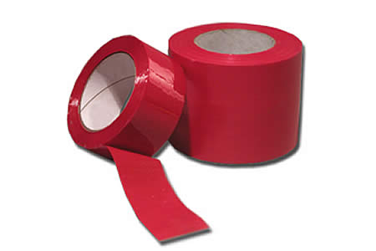

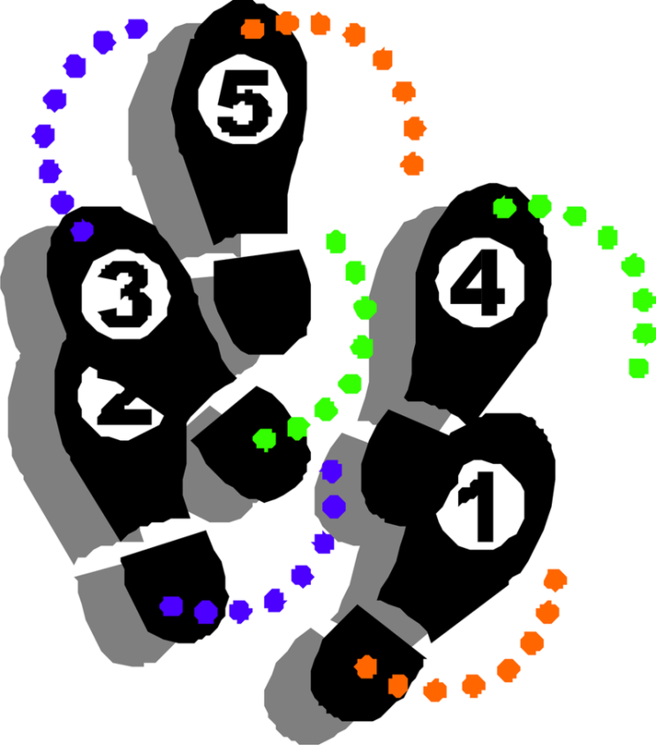
TRAINING EXERCISE

Slide 27


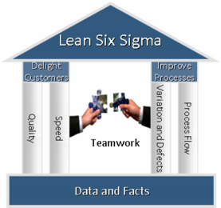

Slide 28
LEAN SIX SIGMA
Lean, pioneered by Toyota, focuses on the efficient operation of the entire value chain.
Focus areas:
  Remove non-value added steps to:
    Reduce cycle time
    Improve quality
  Align production with demand.
  Reduce inventory.
  Improve process safety and efficiency.
Six Sigma, developed by Motorola, made famous by GE, it can be defined as a:
  Measure of process capability
  Set of tools
  Disciplined methodology
  Vision for quality
  Philosophy
  Strategy
Lean Sigma is a combination of two powerful and proven process improvement methods Lean and Six Sigma, that builds on existing organization capability in quality, statistics, and project execution.

Slide 29
LEAN SIX SIGMA
The Roadmap (DMAIC)
Define
  Identify and Prioritize Opportunities
  Select Your Project
  Define the Goals and Objectives
  Form Cross functional Team
  Understand Customer Requirements
Measure
  Define and Analyze the Current Process
  Assess the Capability of the Measurement Process
  Assess the Current Capability of the Process
  Variance Reduction

Slide 30
LEAN SIX SIGMA
The Roadmap (DMAIC)
Analyze
  Identify the Key Input Variables
  Discover the Relationship between the Inputs and Outputs
  Identify the Root Causes of the Problems
Improve
  Identify and Test the Proposed Solutions
  Re-assess Capability
  Implement Solution
Control
  Document Results and Return on Investment
  Take Actions to Hold the Gains
  Celebrate and Communicate

Slide 31
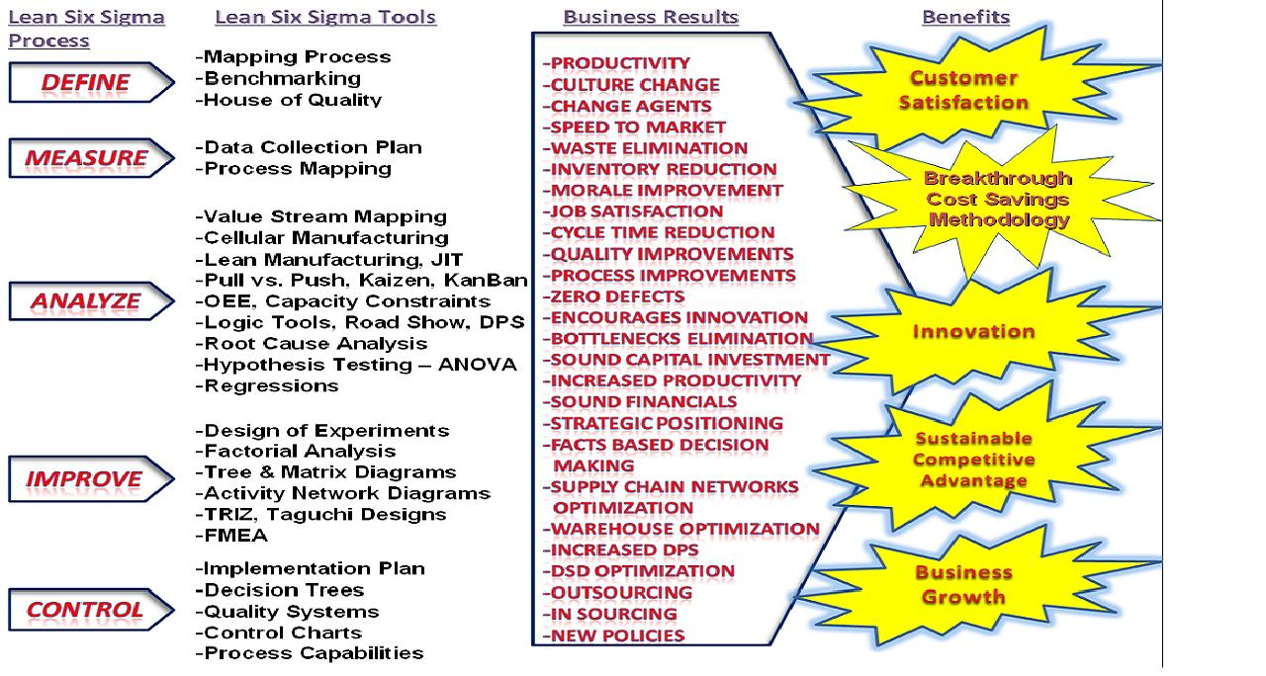
LEAN SIX SIGMA (DMAIC)

Slide 32
LEAN SIX SIGMA
Measurement System Analysis
Glass Inspection Test
Item
Operator 1
Operator 2
Operator 3
Use control charts to
understand & identify
common & special
causes
Test 1
Test 2
Test 1
Test 2
Test 1
Test 2
1
2
3
Map the process to
determine where
defects are being
created
4
5
6
7
Verify assessment/
measurement systems
8
9
10
RISK PRIORITY NUMBER (RPN) =
SEVERITY X 0CCURRENCEX ESCAPED DETECTION
Category
Score
5 4 3 2 1
Run
A
B
AB
y
1
y
2
y
3
. . .
s
1
1
-
-
-
-
+
Severity
(SEV)
Severe High Moderate Minor Negligible
+
2
2
-
-
+
+
-
-
Occurrence Very High High Moderate Low Very Low
(OCC)
3
3
+
+
-
-
-
-
4
4
+
+
+
+
+
Document failure modes
for products and processes
to identify defects' root cause
+
Designed experiments to
make process robust to
variation
Escaped Very High High Moderate Low Very Low
Detection
(DET)
ˆ
=
+
Δ
A
A
+
Δ
B
B
+
Δ
AB
A
•
B
y
y
2
2
2
ˆ
δ
A
δ
B
δ
AB
s
=
s
¯
+
2
A
+
2
B
+
2
A
•
B

Slide 33
LEAN SIX SIGMA
Comparing Lean Six Sigma to Past Tools, Models, & Applications
Differences | Similarities
Sponsored and directed by leadership Aligned with business objectives and tactics Focused on delivering business results Track record for delivering business results Disciplined and systematic execution process Brings in new tools to most companies – DOE, hypothesis testing, FMEA, Kanbans, PokaYoke | Uses many tools already familiar to many people – fishbone, process flow, SPC, brainstorming Aligned with quality efforts Uses a logical problem solving approach that will not be new to some Aligned with past quality and reliability efforts – TQM, Baldrige, Deming

Slide 34
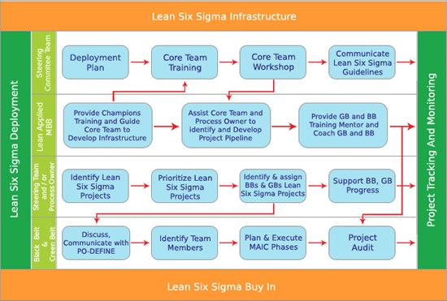
LEAN SIX SIGMA

Slide 35
LEAN SIX SIGMA
R
Walk Through Review
A
L6 Tools Assessment
F
Gap Fill
T
Project Tracking
Monitoring Tactics

Slide 36
LEAN SIX SIGMA
L6 Practitioner
Leadership
Learning & Coaching Ability
Knowledge
Capacity
Personality
Monitoring Tactics

Slide 37
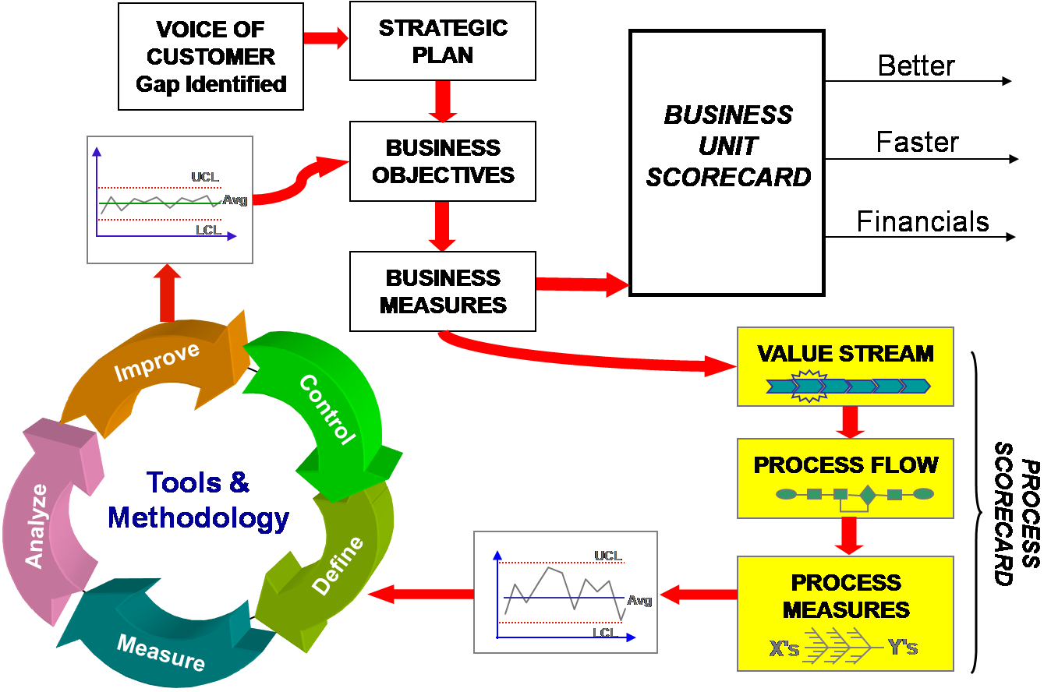
LEAN SIX SIGMA

Slide 38

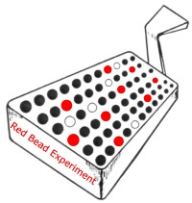
TRAINING EXERCISE

Slide 39
Conclusion
Evolution and History
Lean Operations
Lean Six Sigma
Continuous Improvement
Six Sigma

Slide 40


Slide 41
Lean & Six Sigma
Bret, Cris, & Jeff

